Slide 1
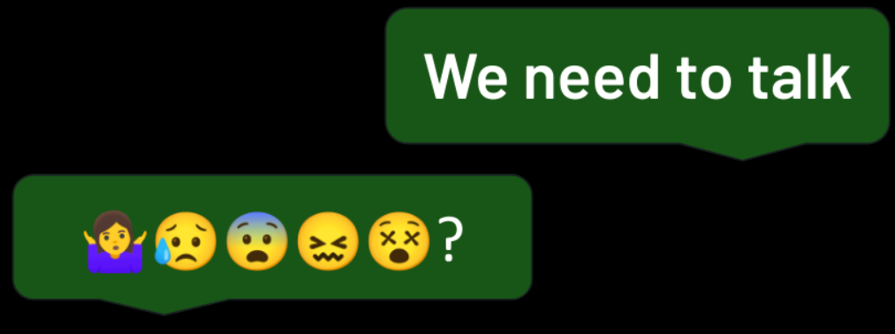
Digital Body Language: Communication in the Virtual World

Slide 2
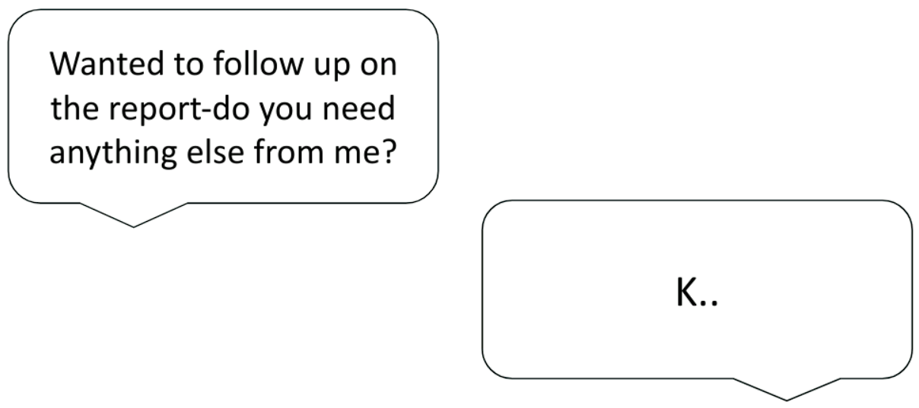
Social Media Etiquette
1
TCS confidential

Slide 3
Digital body language is how we communicate and interpret signals in the online world
Facial expressions in video calls
Response times to messages
Choice of communication channels
2
TCS confidential

Slide 4
Digital Body Language enables:
Building trust and collaboration
Accurate Interpretation of message
Professionalism in workplace
3
TCS confidential

Slide 5
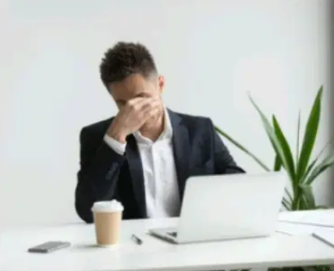

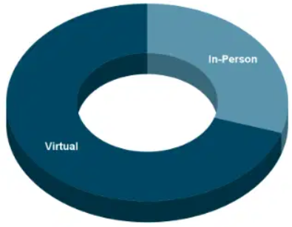
Why It Matters
70% of communication occurs virtually
Misinterpretation leads to decreased productivity
Cultural differences impact digital communication
4
TCS confidential

Slide 6
Emails
5
TCS confidential

Slide 7
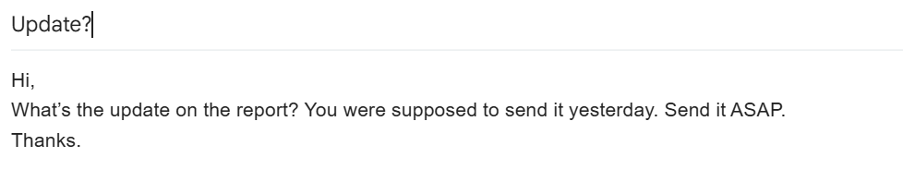
Scenario: Follow-up on a Pending Task
6
TCS confidential

Slide 8
Scenario: Follow-up on a Pending Task
Issues:
No greeting or polite opening
Sounds demanding instead of professional
No proper closing
7
TCS confidential

Slide 9
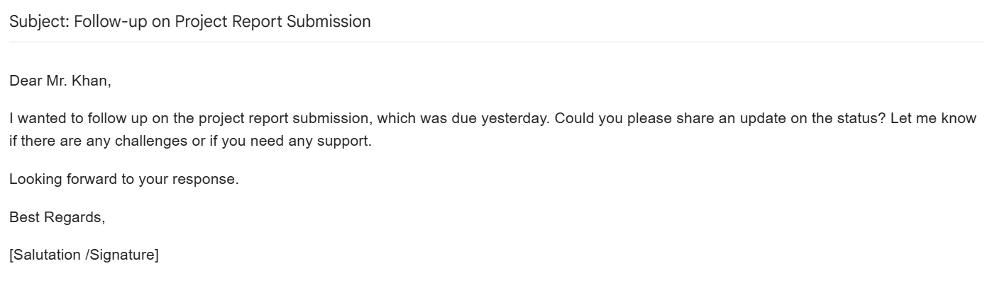
Scenario: Follow-up on a Pending Task
8
TCS confidential

Slide 10






How can we maintain digital body language through email?
Use a clear subject line
Start with a polite greeting
Mind your tone
Be clear and concise
Use professional closings
Proofread before hitting send
9
TCS confidential

Slide 11





Digital Body Language in Video Meetings
10
TCS confidential

Slide 12






Are You Sending the Right Signals in Virtual Meetings?
Are you presenting yourself the right way? Let’s break it down.
11
TCS confidential

Slide 13






Key aspects to keep in mind…
Eye Contact
Posture
Facial Expressions
Gestures
Voice clarity and tonality
Lighting and background
12
TCS confidential

Slide 14
Do’s and Don’ts for Virtual Meetings
Keep camera at eye level.
Avoid Multitasking.
Keep distractions in the background.
Mute when not speaking.
Use excessive hand movements.
Dress professionally.
13
TCS confidential

Slide 15
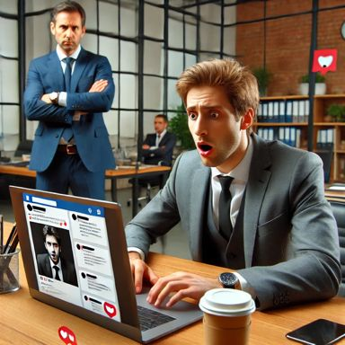
Social Media Professionalism
Separate personal and professional accounts
Maintain a professional tone
Pause before posting
Use hashtags and tags strategically
14
TCS confidential

Slide 16
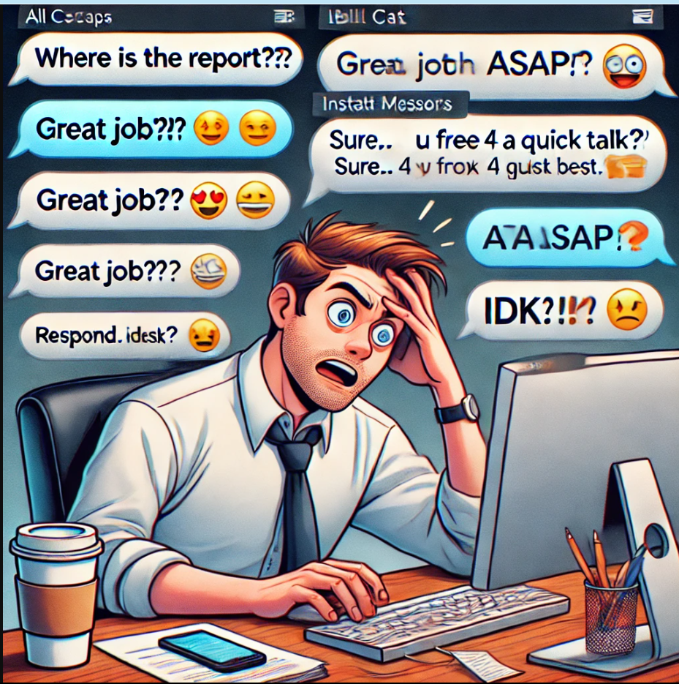
Instant Messaging And
Chat Etiquettes-
Chat is the new face-to-face communication in digital workplaces.
Your words represent you.
Poor chat etiquette can lead to misinterpretation, delays, and workplace conflicts.
Let’s explore how to keep our digital conversations professional and effective!
January 10, 2025
15
TCS confidential

Slide 17
Instant Chats And Meeting Etiquettes-
DOs
Use Complete and concise Sentences.
Keep message relevant and to the point.
Use proper Grammar And Punctuations.
Keep polite tone.
Be mindful about others culture.
Use proper greetings.
Respect Others time and boundaries.
Use proper “@” tags.
Read before you send.
Use proper Acknowledgement.
Respond in expected format.
DON’Ts
Avoid using Slangs & unusual abbreviations.
Using excessive emojis and Caps Locks.
Do not assume.
Do not use Negative language.
Do not disrupt the hierarchy.
Avoid writing Long tags.
Avoid send messages on offtime instead schedule them.
Do not discuss about sensitive things.
Do not take message negatively.
16
TCS confidential

Slide 18
Instant Chats And Meeting Etiquettes-
DOs
Use Complete and concise Sentences.
Use proper Grammar And Punctuations.
Keep polite tone.
Use proper greetings.
Proof read your message and mentions.
Use proper Acknowledgement.
Respond in expected format.
DON’Ts
Using slangs & unusual abbreviations.
Using excessive emojis and Caps Locks.
Assuming anything without evidence.
Using negative language.
Disrupting the hierarchy.
Sending messages off-time.
17
TCS confidential

Slide 19
Instant Chats And Meeting Etiquettes-
Keep It Clear, Professional and Purposeful
“2 PM talk?” Can we discuss project status at 2 PM?
Be Mindful of Tone & Emotion
I NEED THE REPORT NOW ASAP!!! "Hey, could you please send the report when you get a chance? Thanks! 😊"
Respect Response Time & Availability
“???” ”annoying, right?” “Are you there?” "Hey, following up when you get a chance".
Handling Disagreements & Sensitive Topics in Chat
"Why did you change my report?" "Hey, I noticed change in my report, can we discuss it".
Group Chat Etiquette
@everyone, political ideas @releventPerson, general topics
18
TCS confidential

Slide 20

Conclusion
19
TCS confidential

Slide 21

Key Takeaways
Emails: Clear, structured, and professional.
Video Calls: Prepare, engage, and active listening.
Social Media: Maintain a professional online presence.
Chat Messages: Be concise, polite, and respectful.
Online Meetings: Participate actively and professionally.
Tone & Clarity: Ensure your message is understood correctly.
20
TCS confidential

Slide 22

Activity
21
TCS confidential

Slide 23

Which of the following demonstrates professional digital communication?
Using proper greetings in emails
Sending short, unstructured messages
Writing in all capital letters
Responding without reviewing the message
Correct answer: A.
22
TCS confidential

Slide 24

2. True/False
A strong LinkedIn profile has no impact on professional opportunities.
Correct answer: False
23
TCS confidential

Slide 25

Final Thoughts
24
TCS confidential

Slide 26
Thank you
25
TCS confidential

Slide 27
Ask Questions
26
TCS confidential

